Slide 1
Final Project
FRAIG:
Functionally Reduced And-Inverter Graph
資料結構與程式設計
Data Structure and Programming
12/14/2017

Slide 2
Functionally – Reduced – AIG (FRAIG)
AIG: you have learned it in HW#6
Functionally?
  Well, AIG represents a circuit, so it represents some Boolean function.
Reduced?
  Reduction on AIG ➔ Simplifying graph
  How to simplify AIG?
Functionally Reduced?
  Two functionally equivalent nodes can be merged together
  (e.g.) Simplify circuit by constant propagation

Slide 3
Electronic Design Automation (EDA)

Slide 4









How is a “chip” designed nowadays?
= ?
for (i = 0; i < d; i= i+2) {
if (y > 3) p = p * 3;
else q = q + r;
}
always @(posedge clk) begin
if (rst==1'b1) cnt <= sv;
else if (cnt==2'b00) cnt <= 2'b01;
else if (cnt==2'b01) cnt <= 2'b10;
else if (cnt==2'b10) cnt <= 2'b11;
else cnt <= sv;
end
2. Design Verification
1. Design Implementation
3. Design Analysis
Area ?
Timing ?
Power ?

Slide 5
How/What to optimize a circuit?
Area
  Reduce the number of gates
  Moreover, using library cells of smaller sizes
  ➔ but they will have weaker driving capability
Timing
  Shorten the longest path
  Additionally, insert buffers and/or enlarge the cells to increase the driving capability
Power
  Reduce the switching activities
  Moreover, shutdown the sub-circuit that is not currently used

Slide 6
Optimization trade-offs
In general, area, timing, power optimizations contradict with each other
Moreover, different stages of design flow have different granularities and complexities for circuit optimization
  HDL (e.g. Verilog) // algorithm
  Gate (Boolean) // logic
  Schematic (transistor) // cell library
  Layout (wire length) // RC network

Slide 7
A simplified view of circuit optimization
HDL (Verilog)
  Architectural and algorithmic
  optimizations
Gate (Boolean)
  Minimize gate counts under
  reasonable timing and power
  constraints
Layout (transistor)
  Minimize wire length for timing
  and power optimizations with
  limited area overhead
always @(posedge clk) begin
if (rst==1'b1) cnt <= sv;
else if (cnt==2'b00) cnt <= 2'b01;
else if (cnt==2'b01) cnt <= 2'b10;
else if (cnt==2'b10) cnt <= 2'b11;
else cnt <= sv;
end
What FRAIG focuses!!

Slide 8
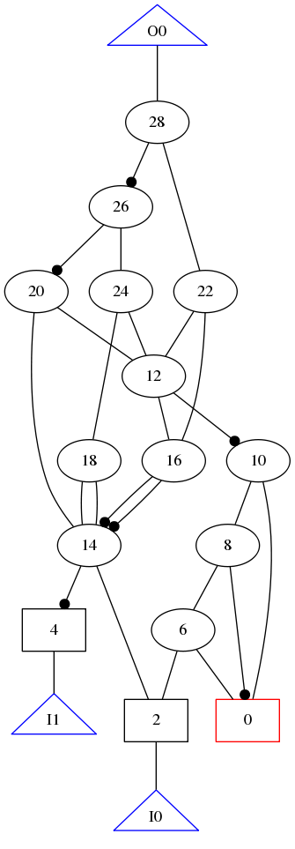
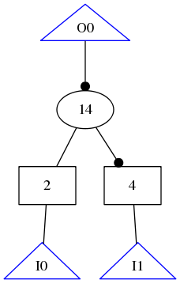
A simple example
sim05.aag
!14
1
0
!14
original:
12 AIGs
!14
14
!14
1
0
0
optimized:
1 AIG

Slide 9
Functionally Reduced AIG
Unused gate sweeping
Trivial optimization
Simplification by structural hash
FRAIG: Equivalence gate merging

Slide 10
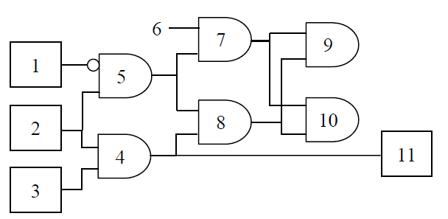
Unused Gate Sweeping
Sweeping out those gates that are not reachable from POs.

Slide 11

Unused Gate Sweeping
Command: CIRSWeep
  Can be called whenever necessary.
  Note: do not remove unused PIs.
  After this command, all gates except for the unused PIs will be in the DFS list.
  Note: be sure to update the reporting for “CIRPrint -FLoating”.
In the previous example (cirp -fl):
  Before:
    Defined but not used: 9 10
    Gates with floating fanin: 7
  After:
    Defined but not used: 1

Slide 12
Functionally Reduced AIG
Unused gate sweeping
Trivial optimization
Simplification by structural hash
FRAIG: Equivalence gate merging

Slide 13
Trivial optimization
f
Fanin has constant 1
➔ Replaced by the other fanin
Fanin has constant 0
➔ Replaced with 0
Identical fanins
➔ Replaced with the (fanin+phase)
Inverted fanins
➔ Replaced with 0
f
a
0
a
f
f
a
0
0
f
a
a
a
0
a
a

Slide 14
A simple example
sim05.aag
14’
1
0
14’
original:
12 AIGs
14’
14
14’
1
0
0
optimized:
1 AIG

Slide 15
Trivial optimization
Command: CIROPTimize
  Can be called whenever necessary
  Scan the DFS list and perform optimization ONCE. Don’t repeatedly optimize the circuit. ➔ The latter can be achieved by calling CIROPTimize multiple times.
  Don’t perform optimization during CIRRead
Do not remove PIs / POs
Some UNDEF or defined-but-not-used gates may disappear!
Some gates (with side input = constant 0) may become “defined-but-not-used”.

Slide 16
Functionally Reduced AIG
Unused gate sweeping
Trivial optimization
Simplification by structural hash
FRAIG: Equivalence gate merging
f1 = AND(a, b)
f2 = AND(b, a)

Slide 17
Structural Hash (Strash)
Example:
6
7
6
4
5
4
1
2
3
1
2
3

Slide 18
Structural Hash (Strash)
Problem: How to identify two AIG gates in a circuit that have the same inputs?
  [Method 1] Check for O(n²) pairs of gates
  [Method 2] For each gate, check its fanouts
    How many checks?
  [Method 3] For each gate, create hash table <fanins, this gate>
    How many checks?
We will pick method 3 in our project
  Please modify your “util/myHashSet.h” for this
Although it is possible to perform strash during circuit parsing, we choose to make “strash” a separate command. ➔ CIRSTRash
Note: Order matters!! You should merge from PIs to POs (Why??)

Slide 19
Structural Hash Algorithm
HashMap<HashKey, HashData> hash;
  HashKey depends on gate type & list of fanins
  HashData is Gate*
➔ What if we have only AIG?
➔ How about inverted match?
class HashKey
{
size_t operator () () const { // as hash function }
bool operator == (const HashKey& k) const {…}
private:
Gate *g0, *g1;
};
HashData can be size_t
size_t in0, in1;
// use LSB for inverted phase

Slide 20
Structural Hash Algorithm
for_each_gate_from_pi_to_po(gate, hash)
// Create the hash key by gate’s fanins
HashKey<...> k(...); // a function of fanins
size_t mergeGate;
if (hash.check(k, mergeGate) == true)
// mergeGate is set when found
mergeGate.merge(gate);
else hash.forceInsert(k, gate);
size_t ? ➔ CirGateV
Create a wrapper class on top of a size_t !!

Slide 21
Notes about CIRSTRash
Perform strash only on gates in DFS list
  Do not perform strash on gates which cannot be reached from POs
  This is to avoid those unreachable gates appearing in DFS list
It doesn’t make sense to perform strash again before doing other optimizations
  CIRSTRash cannot be repeated called

Slide 22
Maintaining Netlist Consistency
Once circuit is simplified, some gates may become invalid.
  How to maintain the netlist consistency?
  Properly re-connect fanins/fanouts
  Properly release memory (if necessary)
  Properly update the lists in CirMgr
  (Note: PI/PO lists should never be changed)

Slide 23
Functionally Reduced AIG
Unused gate sweeping
Trivial optimization
Simplification by structural hash
FRAIG: Equivalence gate merging

Slide 24
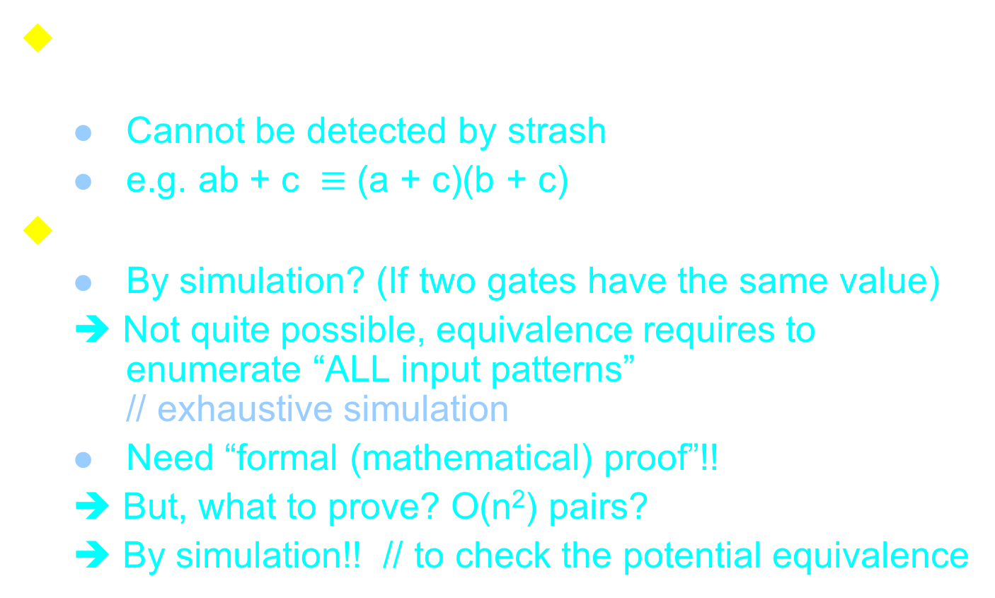
FRAIG: Merging equivalent gates
Some gates are NOT structurally equivalent, but functionally equivalent.
  Cannot be detected by strash
  e.g. ab + c $≡$ (a + c)(b + c)
How to know two gates are functionally equivalent?
  By simulation? (If two gates have the same value)
  ➔ Not quite possible, equivalence requires to enumerate “ALL input patterns”
  // exhaustive simulation
  Need “formal (mathematical) proof”!!
  ➔ But, what to prove? O(n²) pairs?
  ➔ By simulation!! // to check the potential equivalence

Slide 25
FEC Pairs
Functionally Equivalent Candidate (FEC)
  For all simulated patterns, if two signals always have the same response, they are very likely to be equivalent.
Properties
  Two signals can be separated if they have different simulation values for at least ONE input pattern
  Two paired signals can be separated by simulation, but two separated signals won’t get paired again
    Singleton signal won’t be in any FEC pair anymore

Slide 26
Identify FECs by Simulation
G1
0
G1
a
a
a
0
b
1
G1
b
0
b
0
(b, c) is a FEC pair
1
0
c
c
0
c
check FEC groups
check FEC groups
1
d
G2
d
0
d
1
e
e
1
e
Simulate
Simulate
Simulate

Slide 27
Identify FECs by Simulation
Initial: put all the signals in ONE FEC group.
Add this FEC group into fecGrps (list of FEC groups)
Randomly simulate the entire circuit
for_each(fecGrp, fecGrps):
  Hash<SimValue, FECGroup> newFecGrps;
  for_each(gate, fecGrp)
  grp = newFecGrps.check(gate);
  if (grp != 0) // existed
  grp.add(gate);
  else newFecGrps.add(createNewGroup(gate));
  CollectValidFecGrp(newFecGrps, fecGrp, fecGrps);
Repeat 3-4 until no new FEC Group can be identified, or efforts exceed certain limit.

Slide 28
Simulation Algorithm
All-gate simulation:
Perform simulation for each gate on the DFS list
  void CirMgr::simulate() {
  for_each_gate(gate, _dfsList) gate->simulate(); }
Event-driven simulation:
Perform simulation only if any of the fanins changes value
  void CirMgr::simulate() {
  for_each_PO(po, _dfsList) po->simulate(); }
  bool CirAigGate::simulate() {
  Recursively simulate each fanin.
  If (no fanin has value change) return false;
  Simulate this gate;
  if (value changed) return true;
  return false;
  }

Slide 29
Discussions: Simulation algorithm trade-offs
All-gate simulation or event-driven?
Evaluation
  By operator? By if-else? By table lookup?
To detect FEC pairs, how many simulation patterns are enough?
  Stop if no new FEC pair is found?
  (Dynamically) Controlled by “#failTimes”
Patterns
  Single pattern? Parallel pattern?

Slide 30
Parallel-Pattern Simulation for FEC Identification
Note: The speed overhead in bitwise operations is very small.
  Most of the programming languages (e.g. C/C++) support “bit-wise” operations (e.g. &, |, ~ in C).
Idea
  Using 32- or 64-bit unsigned integer to pack 32 or 64 patterns into a word
w₁ & w₂
unsigned integers
010.... 101
Circuit
110.... 011
bitwise operation
011.... 110
w₁
w₂
simulation patterns

Slide 31
How many patterns to parallelize?
In practice, max parallelization will lead to the best simulation performance
  Use the max “unsigned int” to store the parallel patterns (e.g. size_t in C/C++)
[Discussion]
Can we go beyond 32/64 bits?
  e.g. 1024-bit
What are the pros and cons?
How about the FEC detection rate?

Slide 32
Mass simulation → Identify FEC pairs
How to prove/disprove gates in an FEC pair are equivalent?
Convert it into a SAT problem!!!

Slide 33
Boolean Satisfiability Problem
Given a Boolean function f(X), find an input assignment X = A such that f(A) = 1.
  Satisfiable: if such an assignment is found
  Unsatisfiable: if no assignment is possible
    i.e. All assignments make f(X) = 0
  Undecided: can’t find a satisfying assignment, but haven’t exhaust the search
  SAT Game: https://goo.gl/9JJVmJ
Complexity?
  First proven NP-complete problem by Dr. S. Cook in 1971 (Turing Award winner)

Slide 34
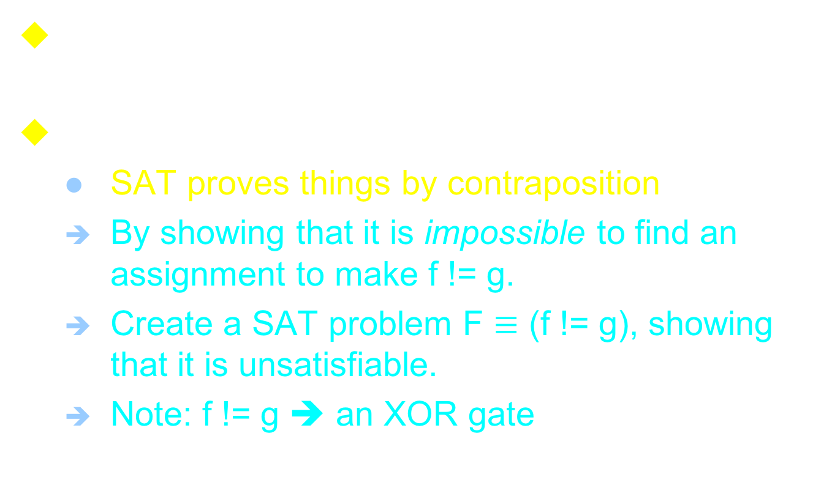
How to prove the equivalence of FEC gates?
In general, given two Boolean functions, f, g, how to check if they are equivalent?
Note:
  SAT proves things by contraposition
  By showing that it is impossible to find an assignment to make f != g.
  Create a SAT problem F $≡$ (f != g), showing that it is unsatisfiable.
  Note: f != g ➔ an XOR gate

Slide 35
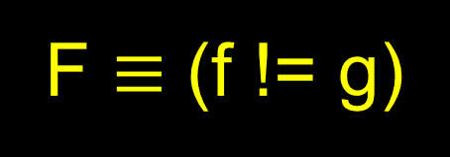
How to prove the equivalence of FEC gates?
F $≡$ (f != g)
(f, g) is an FEC pair
➔ SAT? (F = 1)
If UNSAT ➔ f = g
g
f
If SAT ➔ f != g with an input assignment A that can distinguish (f, g) and potentially distinguish other pairs
PIs

Slide 36
FRAIG flow
Simulation
  Put all signals in the same group
  Simulate the circuit. If two signals have different simulation results, separate them into different groups
  Repeat (b) until no more signals can be distinguished, or the simulation efforts exceed a preset limit
  Collect the functionally equivalence candidate (FEC) pairs

Slide 37
FRAIG flow
For each FEC pair, call Boolean Satisfiability (SAT) engine to prove their equivalence
  If they are equivalent, merge them together ➔ remove one of them
  If they are NOT equivalent, acquire the counter-example (CEX) to distinguish them
  Repeat until all the FEC pairs have been proved, or enough CEXes (2.2) have been collected ➔ Repeat simulation

Slide 38
In short...
Simulation identifies a group of FEC pairs
For each FEC pair, say (f, g), call SAT engine to check if (f != g) is satisfiable
If UNSAT ➔ f = g ➔ f can replace g
If SAT
➔ collect the pattern that witness (f != g)
➔ simulate again to see if it can distinguish other FEC pairs
Repeat 2 ~ 4
➔ So the remaining problems are: How to call SAT engine? How to create SAT proof instance?

Slide 39
Boolean Satisfiability Engine
A engine (i.e. a program/library/function) that can prove or disprove a Boolean Satisfiability problem
  Called a “SAT engine” or “SAT solver”
A well-studied CS problem, but was once generally thought as an intractable problem.
  Many practical, powerful, and brilliant ideas were brought up by EDA researchers in early 2000 ➔ Orders of improvement
  Made a revolutionary change on the applications of SAT

Slide 40
Creating Proof Instance
Proof instance: the formula under proof
Conjunctive Normal Form (CNF)
  Most modern SAT engines represent the proof instances in CNF
  Actually a “product of sum” representation
  To be satisfied, all the clauses need to be 1
(a+b+c)(a’+b’+c)(a’+b+c’)(a+b’+c’)
Variables
Literals
Clauses

Slide 41
Converting circuit to CNF
Each gate is assigned a variable ID
Each gate is converted to a set of CNF clauses based on its fanin variables
  g = AND(a, b)
  a = 0 → g = 0 (a + !g)
  b = 0 → g = 0 (b + !g)
  a = 1 & b = 1 → g = 1 (!a + !b + g)
To solve (f = 1), add a (f) clause
  SAT engine is to check if all the clauses can be satisfiable at the same time.

Slide 42
Converting circuit to CNF
Example:
SAT [6] = 1
(1 + !4)(3 + !4)(!1 + !3 + 4)
(4 + !6)(2 + !6)(!2 + !4 + 6)
(6)
6
4
1
2
3

Slide 43
Calling SAT engine
Create a solver object
Add clauses → proof instance
(optional) Set proof limits
Solve()!!
➔ We provide a SAT interface in “sat.h”
(FYI) Incremental SAT
  Reuse the partial learned information

Slide 44
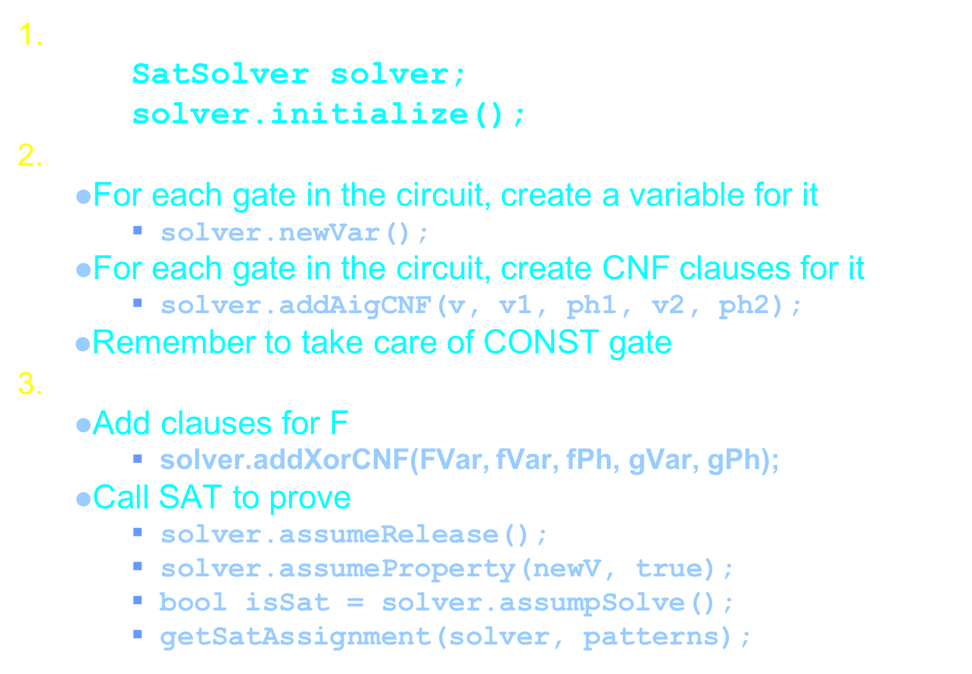
Using SAT to prove FEC pair
Create a solver object
  SatSolver solver;
  solver.initialize();
Create CNF for the circuit
  For each gate in the circuit, create a variable for it
    solver.newVar();
  For each gate in the circuit, create CNF clauses for it
    solver.addAigCNF(v, v1, ph1, v2, ph2);
  Remember to take care of CONST gate
Create the proof instance for F $≡$ (f != g)
  Add clauses for F
    solver.addXorCNF(FVar, fVar, fPh, gVar, gPh);
  Call SAT to prove
    solver.assumeRelease();
    solver.assumeProperty(newV, true);
    bool isSat = solver.assumpSolve();
    getSatAssignment(solver, patterns);

Slide 45
Notes about FEC proof
Order matters!!
  Proving from PIs to POs can greatly reduce the proof effort
  DFS or BFS?
Don’t waste SAT-generated patterns (for f != g)
  Pack them for parallel pattern simulation
Many FEC pairs are actually (f, 1) or (f, 0).
  Should we do anything special for them?
It’s OK to skip some proofs. (Why?)
  Skip it or limit the proof effort (e.g. #conflicts)
Incremental SAT
Balance between simulation and proof efforts

Slide 46
Some advices
Please do not fall into 軍備競賽...
  Although it is possible you can implement a version that is 10X faster than mine...
It’s OK that you CANNOT finish the project.
  I don’t expect many people to finish the project.
  Think: 你的電子學有拿 100 分嗎?
Please DO NOT spend 80% time on 20% points
  e.g. parser error message, circuit optimization
Always keep your code simple and straight!!
  Always modularize your code
  Compile and test from time to time

Slide 47
References
Functionally Reduced And-Inverter-Graph
  http://www.eecs.berkeley.edu/~alanmi/publications/2005/tech05_fraigs.pdf
A System for Sequential Synthesis and Verification
  http://www.eecs.berkeley.edu/~alanmi/abc/
SAT solver
  http://www.satcompetition.org/
  http://www.princeton.edu/~chaff/publication/DAC2001v56.pdf
  http://www.princeton.edu/~chaff/publication/cade_cav_2002.pdf

